Slide 1
Challenges and solutions in Logistics for Building in Alaska
Moolin
Seminar
December 3, 2018
Notes:
Thanks for the opportunity to speak.
I’ve worked for Lynden 20 years this spring. Prior to working for Lynden I worked for a heavy equipment dealership. We had equipment from Dutch Harbor to Prudhoe Bay with mechanics working all the way to Antarctica

Slide 2
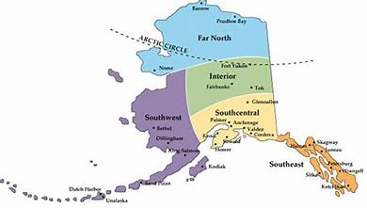
Notes:
Alaska is very diverse where often there are limited resources in respect to logistics for projects. Often everything that is required for a project needs to travel to the site. Depending on the location equipment may need to site until the next season in order to return.
Couple things to remember when shipping to Alaska, most vendors primary concern is getting the material if their dock and invoice in the mail.
The lower 48 states are busy and Alaska is a very small market when compared to other markets, Alaska is important to us but maybe not as important to some vendors that are busy with projects that are closer and require less special handling.

Slide 3
Southcentral
Barge / Rail
Steam Ship
Truck
Southeast
Barge
Truck / Ferry
Western Alaska
Barge

Slide 4
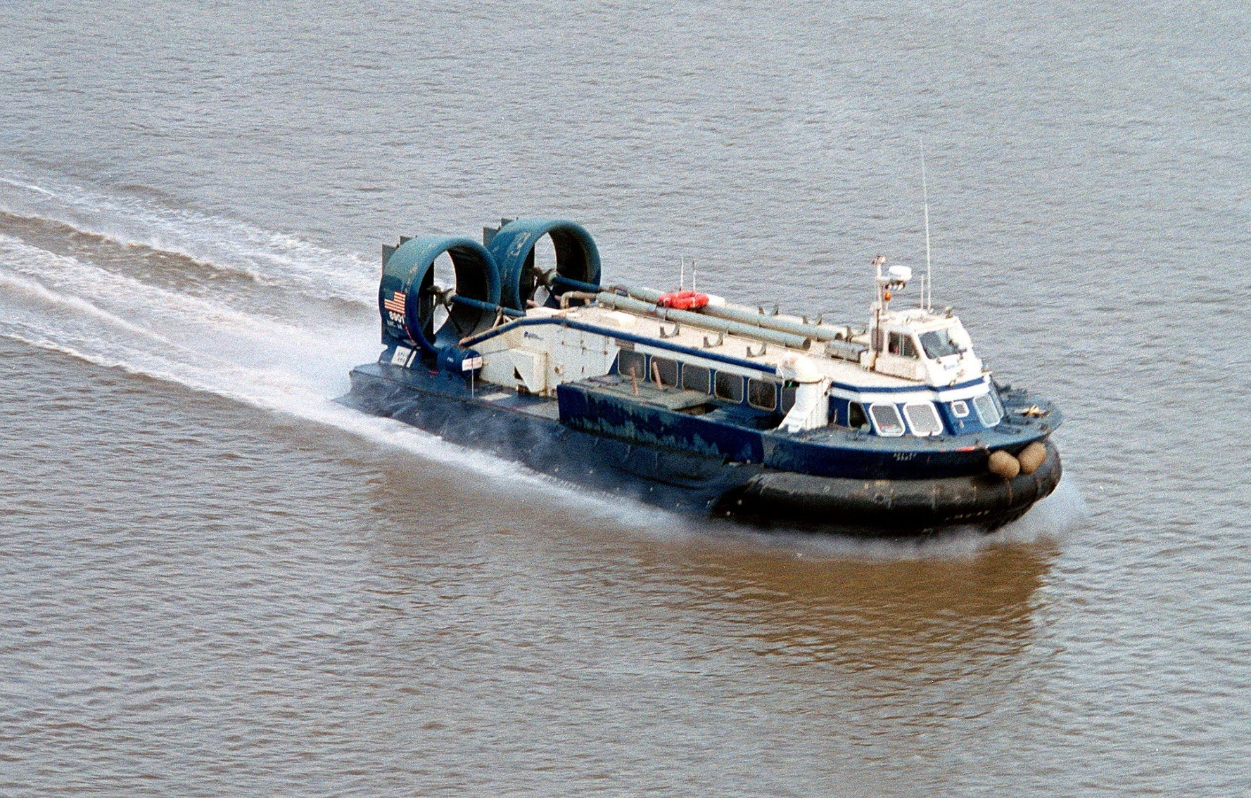
Notes:
With Alaska’s unique and sensitive terrain such as tidal flats, ice, snow and sand often requires specialized equipment. Above is one of Alaska Hovercraft’s hovercraft operating on the Kuskokwim. The above unit with favorable conditions would be able to handle approximately 42,000 of freight. Make sure and recognize and explore what your transportation options maybe, though options may be available they come with a cost.

Slide 5
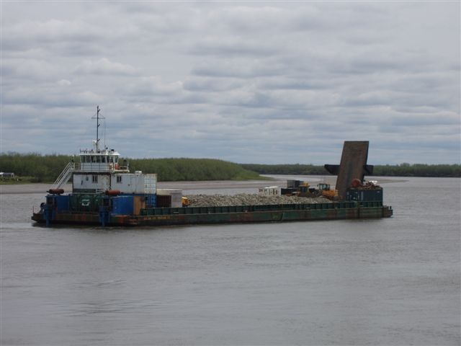
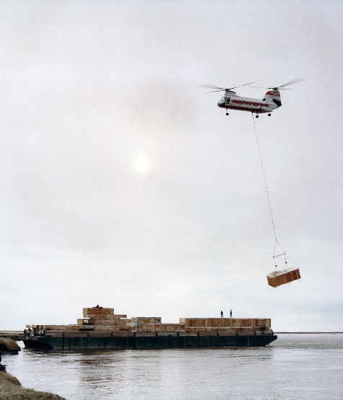
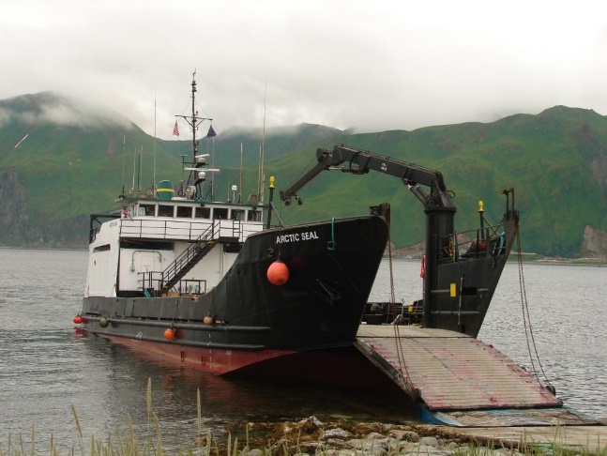
Notes:
Many of the communities of Alaska are water-locked and not serviced by a road system requiring specialized equipment to deliver equipment, materials and supplies, often including gravel for foundations. There are times when these villages are only serviced once a year so have to be prepared to have equipment winter over one season to the next. Above are some of the tools of Bering Marine has used in supporting remote Alaskan projects.

Slide 6
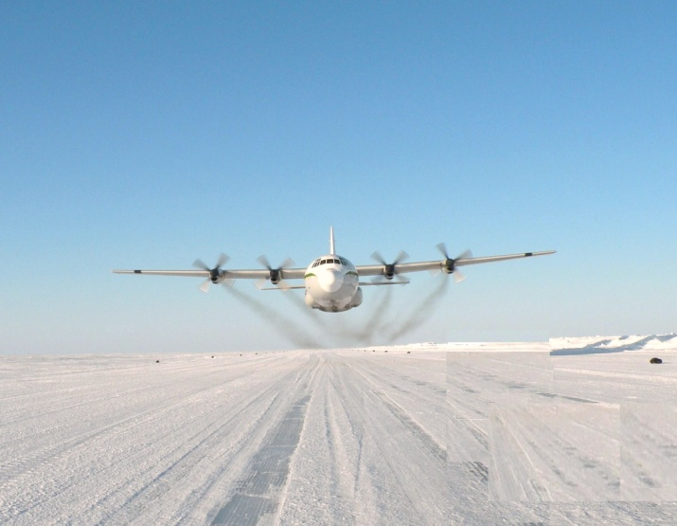
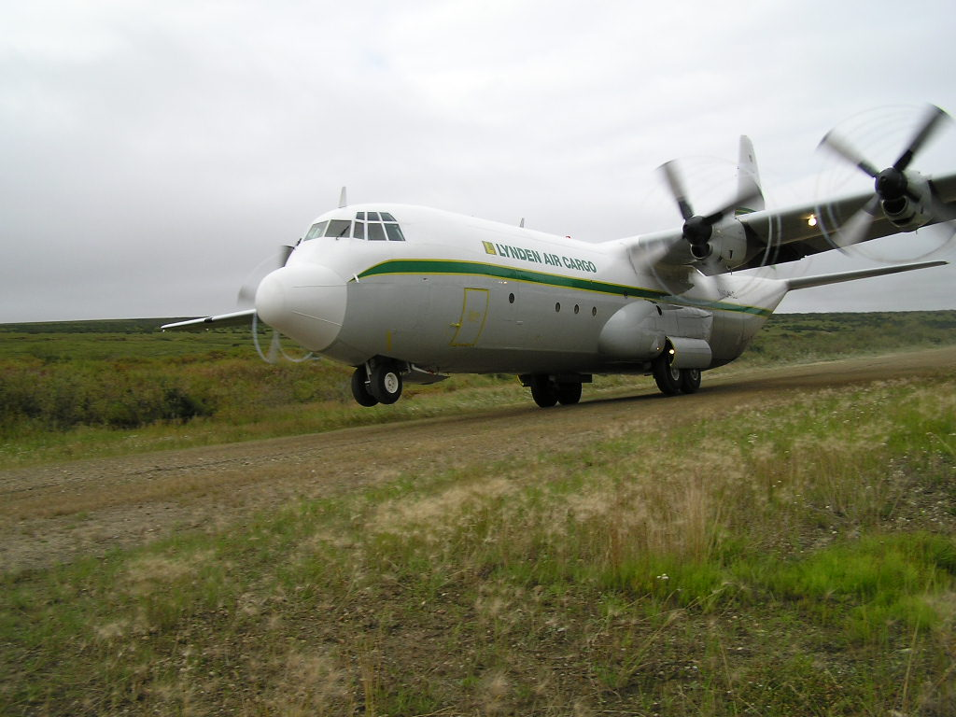
Notes:
When working projects in some of the remote places in Alaska require air support. The airplane has been key to Alaska since the early years and continues to support many projects in Alaska, Northern Canada and the rest of the world for that matter. Above shows some of the common areas the L-382 Hercules operates in.
Often the Herc is called when no other means to move material maybe available or able to respond fast enough.
A few years ago when the Dalton Highway was flooded because of icing on the Sag River the Herc was called on to fly fuel and critical support equipment to the Slope otherwise there was serious threat of operations shutting down.
The Herc has cargo capacity of 48,000 pounds of freight – 54’ x 10’ x 9’

Slide 7
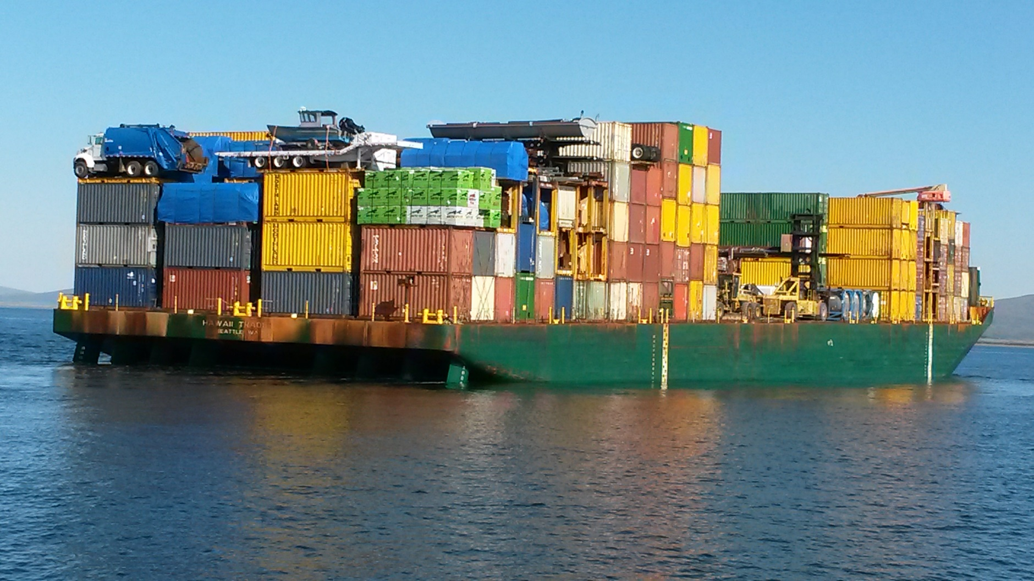
Barge Arriving in Nome
Notes:
..

Slide 8
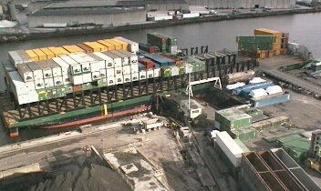
Notes:
When bidding construction projects there are often different modes of transit for moving materials to Alaska. It is important to recognize what the modes are and their differences. For projects that require multiple shipments with specific timelines it is not uncommon to route the initial loads via a faster highway or steamship routing with subsequent shipments not as time sensitive to move via a barge mode saving money in transportation cost. Above is an Alaska Marine Lines barge being loaded in Seattle. Notice the containers are stacked on racks, the lower deck area is for rail cars heading to Alaska.

Slide 9
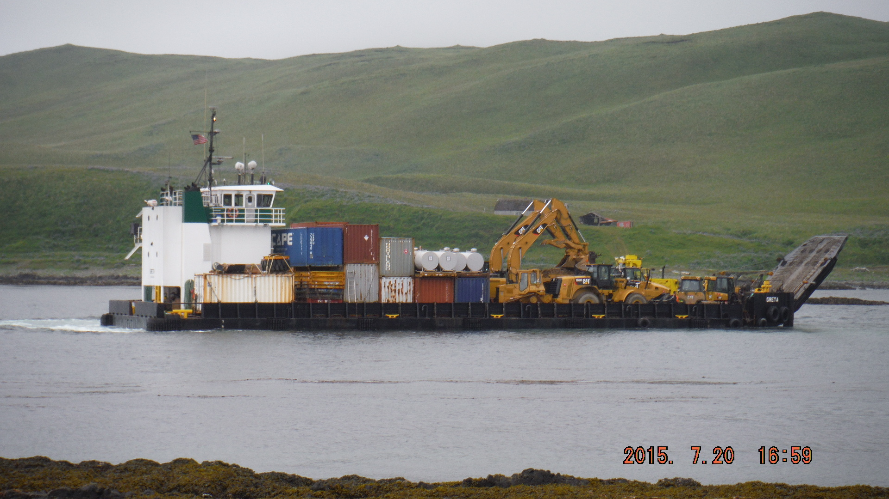
Landing craft delivery in rural Alaska

Slide 10
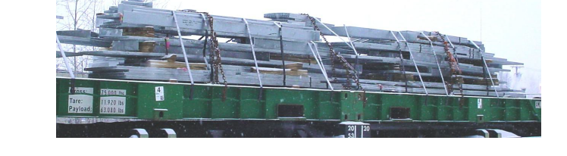
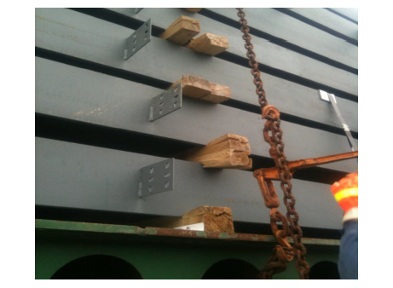
Notes:
Know your freight and recognize that there are often different requirements for shipping to Alaska than transportation within the lower 48 states. Shipping structural steel is a prime example of different shipping requirements. Structural steel traveling to Interior Alaska often travels via ocean, rail and highway and all have slightly different shipping requirements. In the states many shippers will use a soft wood as dunnage for steel, soft wood is not suitable for transit via water carriers and will often be rejected and will require the loads to be taken apart and reworked before they can travel beyond the port of Seattle. Reworking loads causes extra time and money to shippers. When working on projects make sure your shipper and carrier understand what the freight is an you understand what the requirements are
• Steel on steel loading is prohibited.
• All dunnage must be wider than it is high.
• Multiple pieces of blocking or dunnage stacked in layers must be firmly nailed to each other.
• Dunnage should be of sufficient size and number to easily support the load. 4 x 4’s preferably of hardwood construction are recommended.
• Cross beams should be located approx.. 8 inches inboard each end of the load and spaced equally along its length, no greater than 8’ apart.
• Cross beams should span the entire width of the load when possible.
• Multiple layers of cross beams should be arranged in a vertical manner.
• Stickers should be affixed to each end of cross beams to prevent lateral movement.
• Gaps between pieces on a layer should be blocked to prevent lateral movement

Slide 11
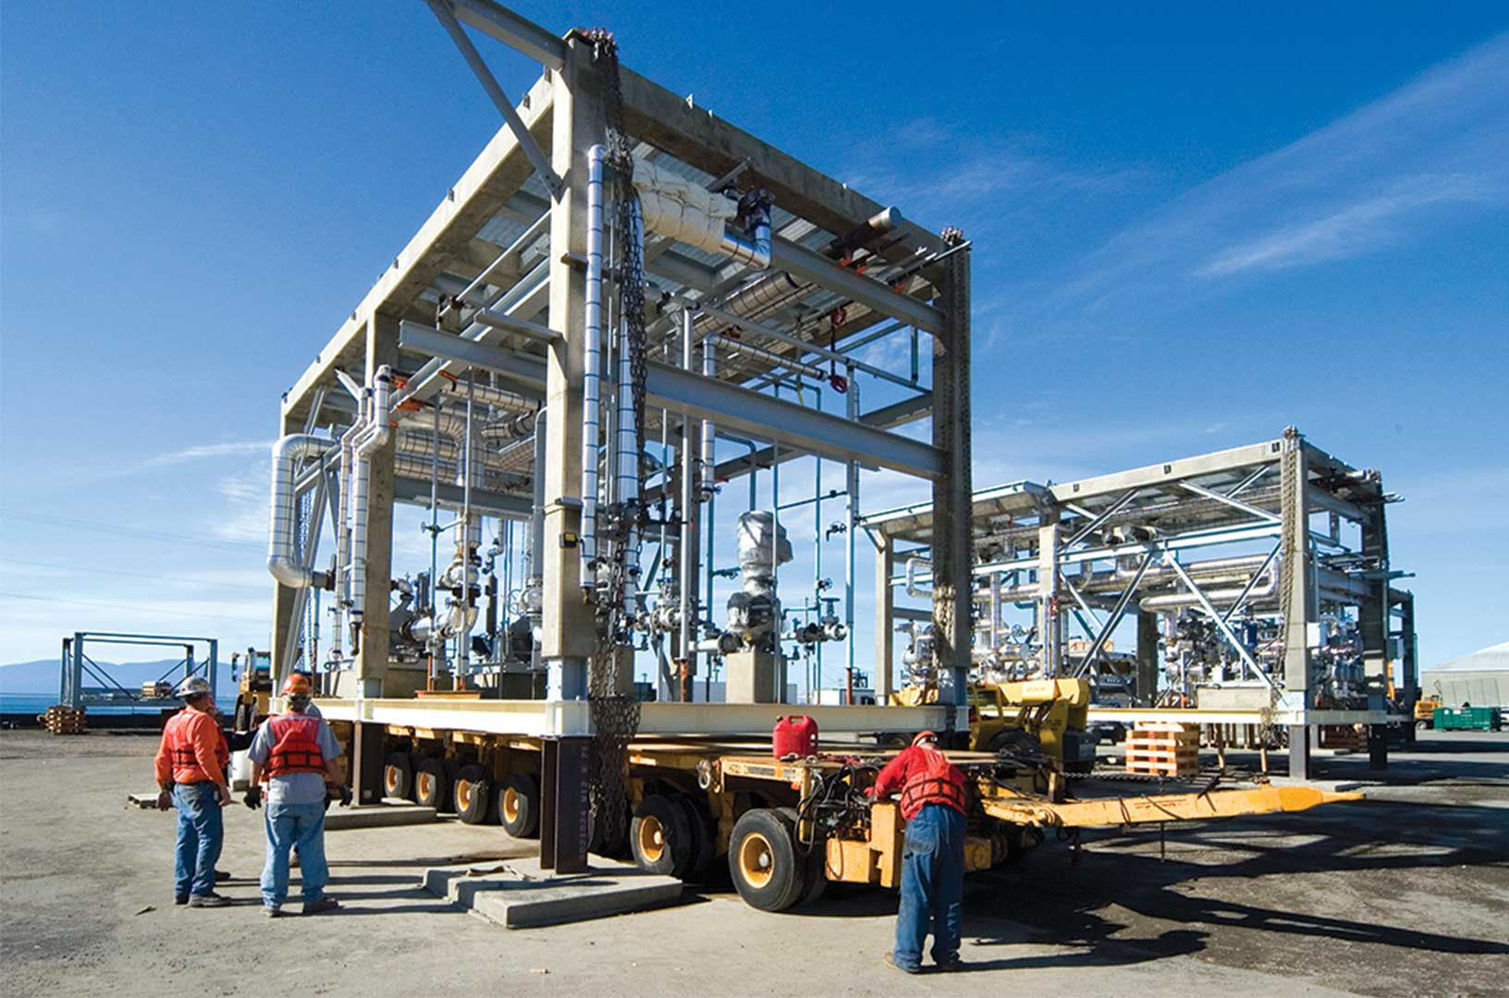

Slide 12
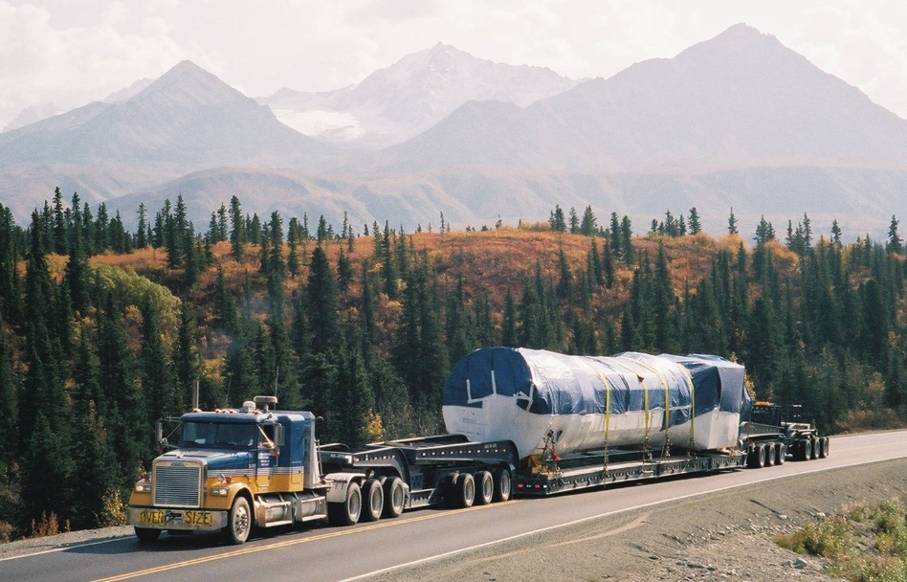
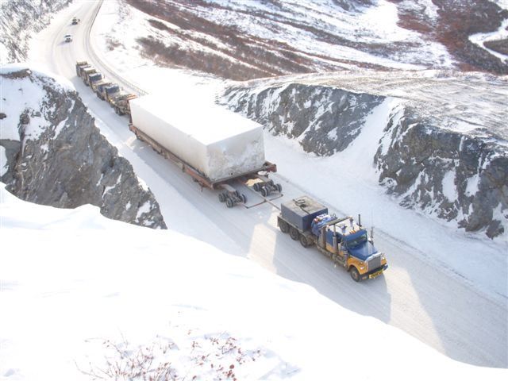
Notes:
Heavy haul is a fact of life in Alaska which often requires specialized equipment. When planning projects that require heavy or oversized loads it is important to plan ahead and recognize that if you do not plan ahead for these out of the ordinary moves you could be out of luck for months and if don’t plan ahead may be totally out of luck. When planning jobs in the Interior remember there are two roads the Parks and the Richardson both have pinch points that can limit the size of loads moving via the highway. When traveling on the Richardson look at the Tanana River Bridge and on the Parks the Rail Bridge just south of the Denali Park entrance, have to fit under them. Recall what happened to the trucking company that tried to move a module under and overpass north of Anchorage a couple years ago, destroyed the mod unit damaged the overpass which required expensive repairs.
Above are a couple oversized loads done by Alaska West, on the left is a load for the Greely Missile Defense project, on the right is a module making its way north on the Dalton, this load required push trucks behind the load in order to move north

Slide 13
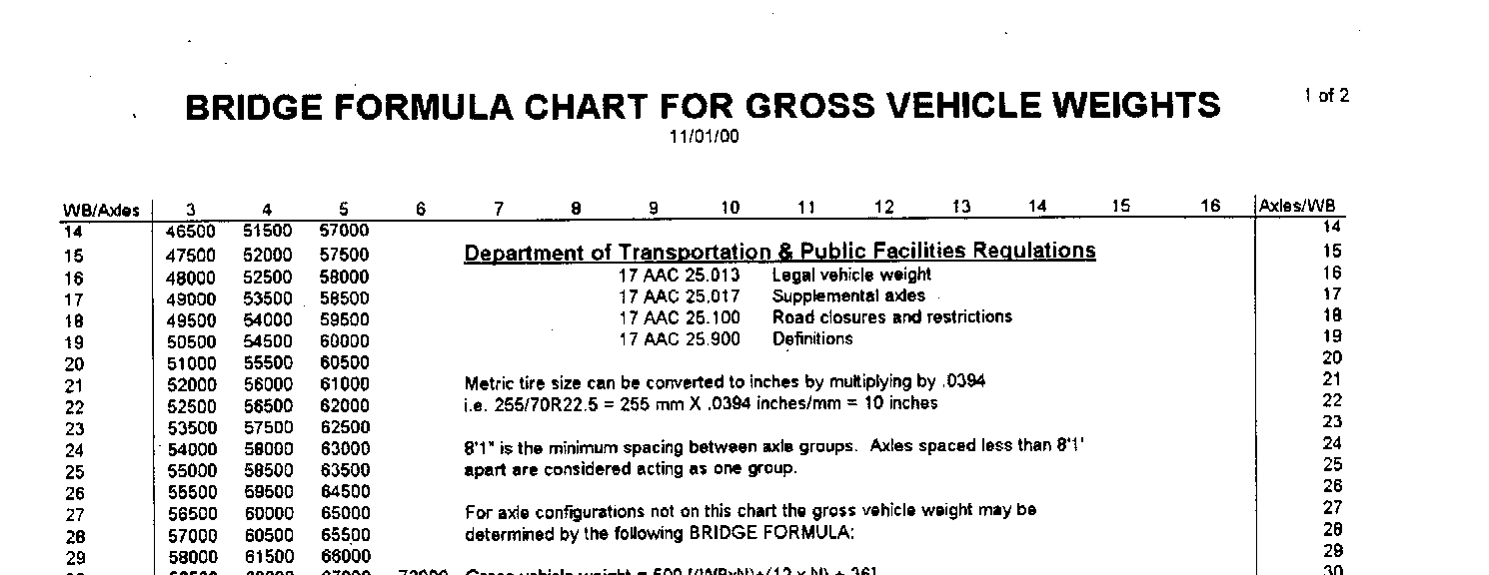
Notes:
Recognize the limited road system in Alaska and the many limitations don’t assume the client has all the information or is always sharing pertinent information

Slide 14
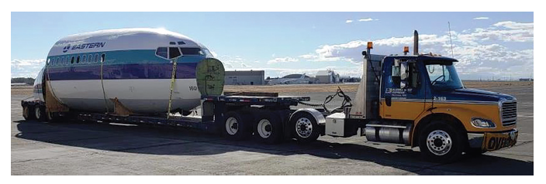
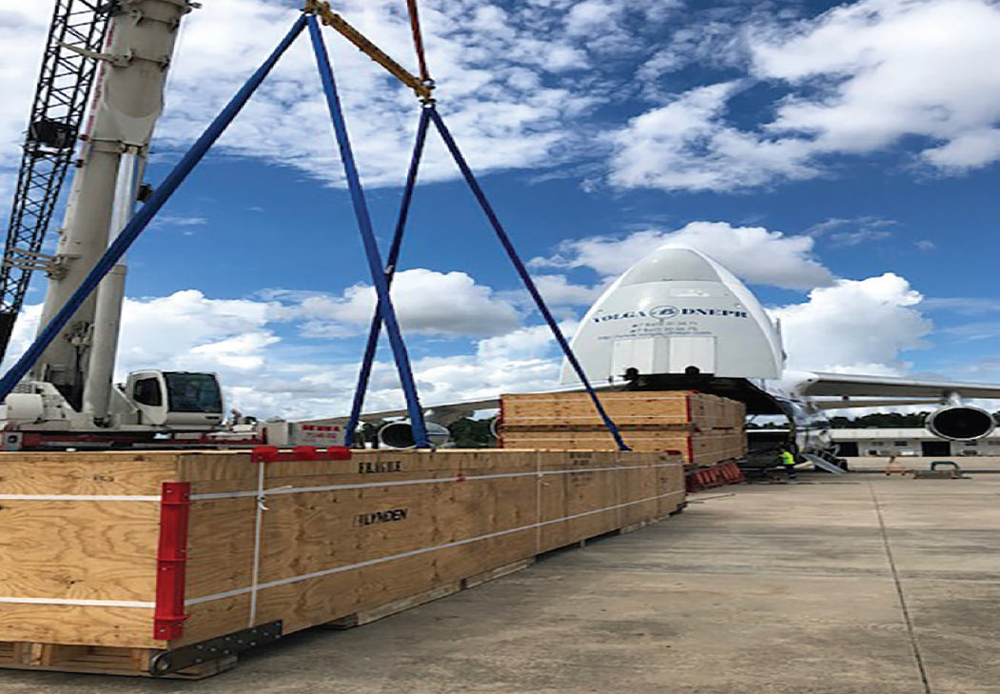
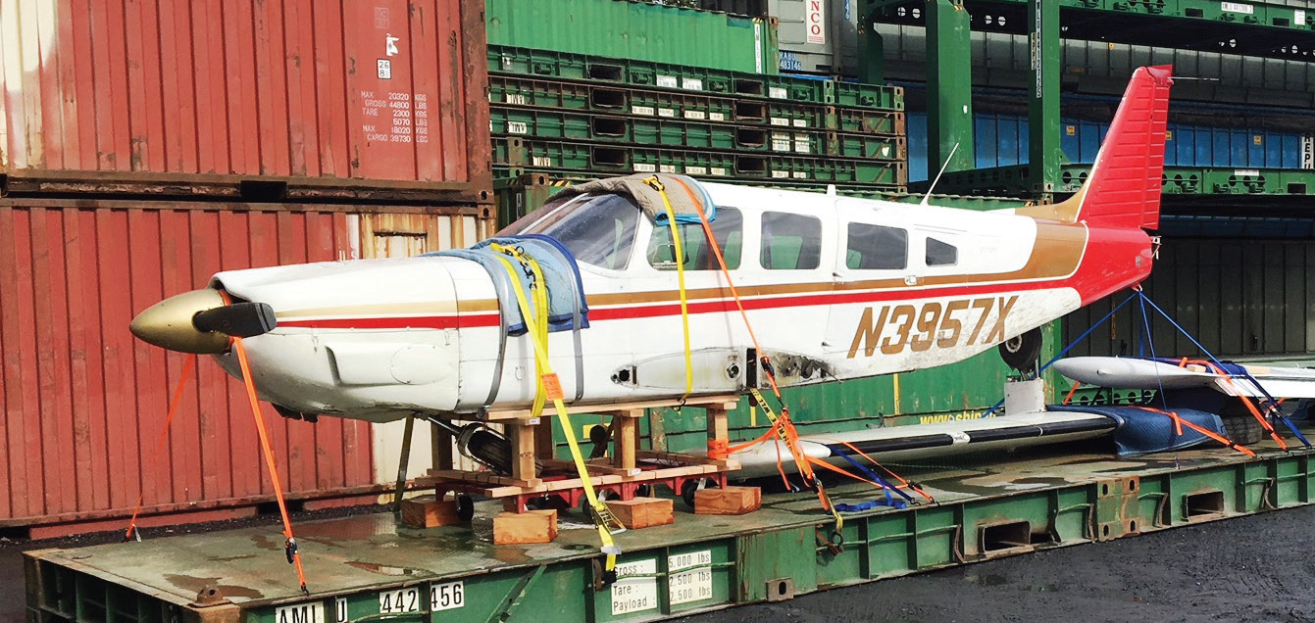
Notes:
Working in Alaska there are opportunities to be involved in a variety of unique moves, from vintage airplanes to wrecked planes to charters of some of the largest cargo aircraft in the world.

Slide 15
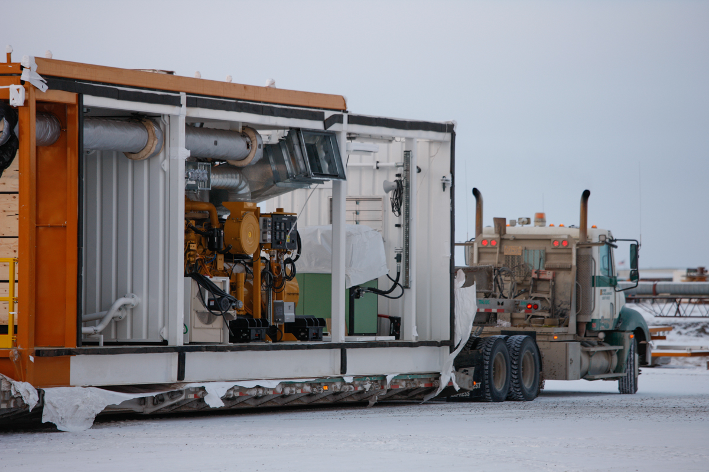

Slide 16
Vendor and suppliers
A few things to consider when working projects in Alaska.
Most shippers have no idea of how material delivers in Alaska.
Many shippers consider shipping to Alaska an international shipment, you will assume transportation cost.
Often shippers will not consider transportation to Alaska when packaging, no one likes to deal with damage.
Schedules will be challenged.
Make sure vendors properly label your freight.

Slide 17
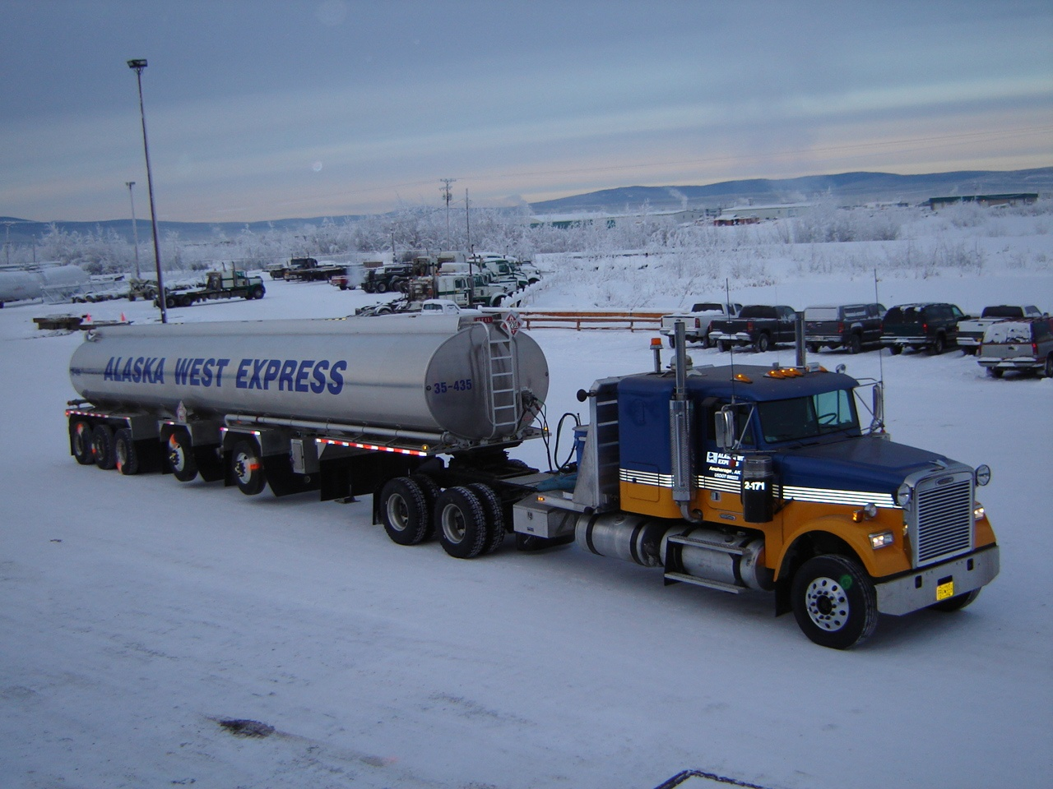
Notes:
New AWE truck & 5 axle tank – January 2007
WEIGHT?
Twin lift axles?

Slide 18
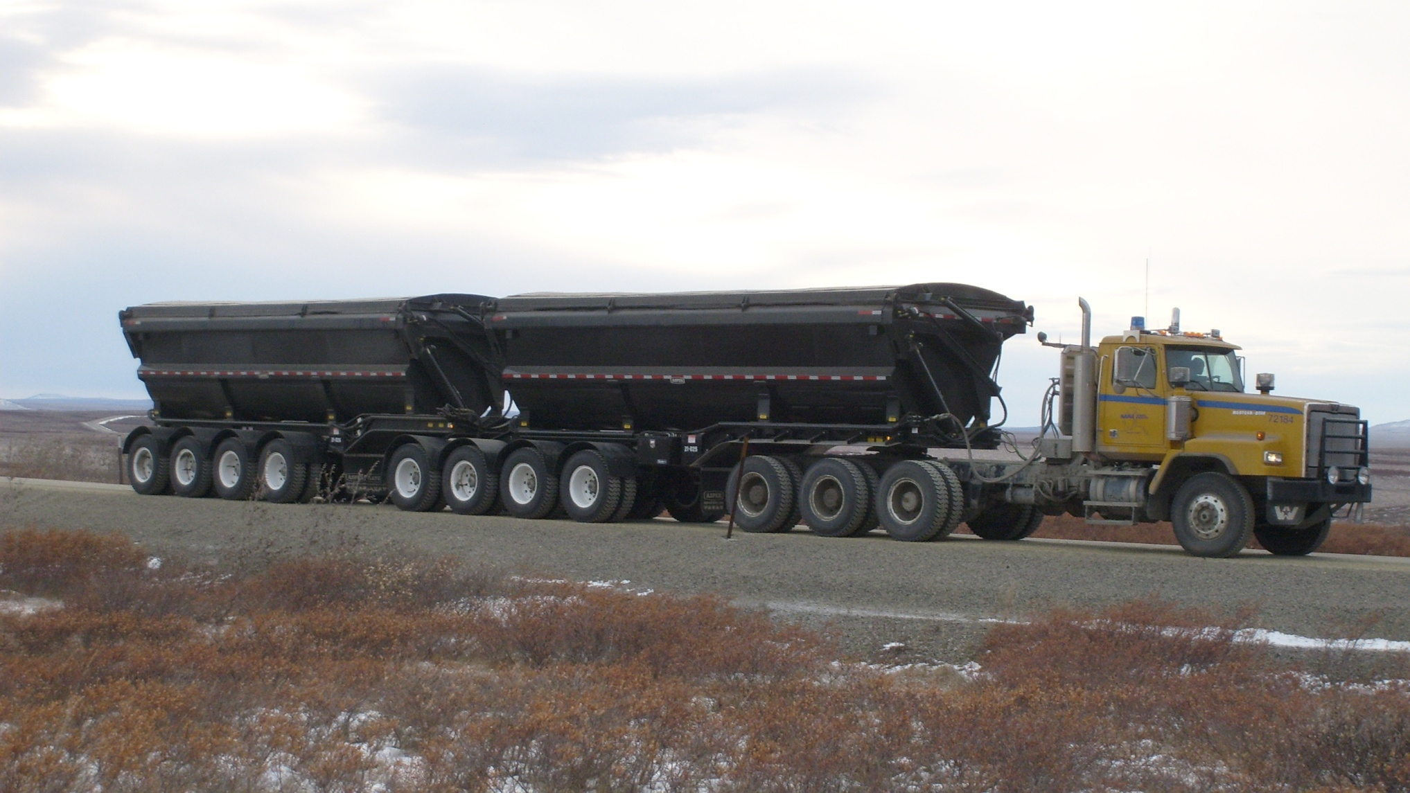
Notes:
130,000 WMT
Alaska has regions that maybe exempt from some specific DOT requirements, know the area in which you will be operating, above is a ore hauling truck operation for the Red Dog Mine, a private mining road.

Slide 19
